Slide 1
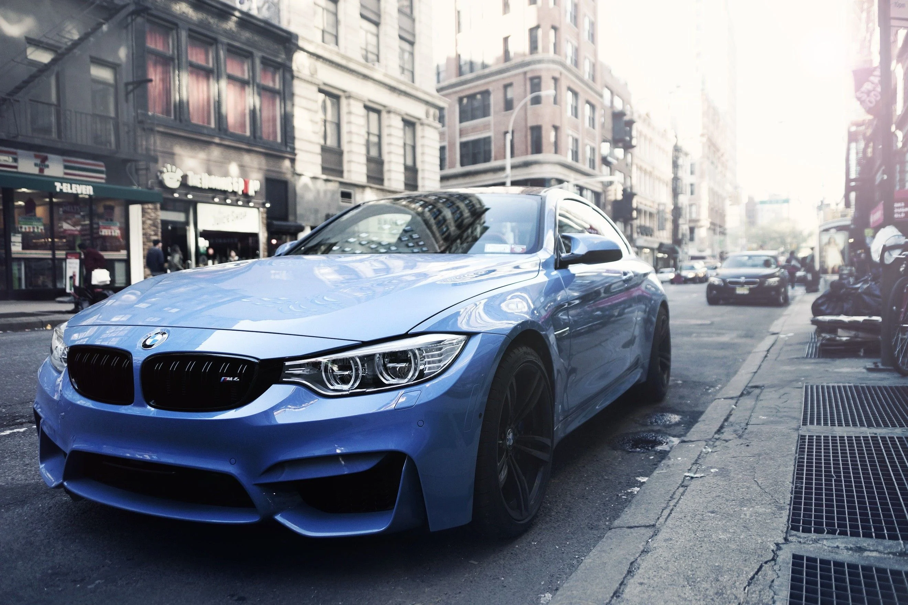
German cars data Analysis by Pavel Liaoshka
PRESENTATION

Slide 2



Table of contents
Table of contents
Data and project overview
Data cleaning process
PROJECT
Statistical information
Graphical representation of insights
Top collections
Conclusion

Slide 3
Data description
Data description
Source dataset contain data from one of the largest Europe’s car market AutoScaut24 from 2011 to 2021.
Original dataset consists of 46405 rows and 9 columns
Fields contain information about make, model, price, offer type, mileage, fuel, gear type, horsepower and production year.
.
Data was downloaded from Kaggle.com Collection method – scraping.
Link: https://www.kaggle.com/datasets/ander289386/cars-germany

Slide 4





Project objectives
Project objectives
Data cleaning
Data Analysis
Statistical Analysis
Discovering insights
Graphical representation
Our project will start by revealing gaps and inaccuracies in the data that can interfere with the analysis and then eliminating them.
Use Pandas, NumPy, and other Python libraries for investigating our data and searching for interesting information and insights.
Using Pandas functions to obtain statistical information about data and identify relationships between variables.
Discovery of interesting points that are worth paying attention to and on which it is possible to conduct further research.
Using the Python Matplotlib library to represent findings using various types of visualization

Slide 5
Data cleaning
Data cleaning
Different Pandas functions were used to clean and prepare the data for analysis. Process followed the scheme:
Checking and Changing data formats where necessary
Replacing, dropping null values in columns
Replacing incorrect values
Checking data for problems, inconsistencies
Verification of results
More details can be found in my GitHub portfolio and the attached Jupiter notebook.
Resources

Slide 6
Dataset stats
Dataset stats
Correlation coefficients
Descriptive statistics
 | mileage | price | hp | year
mileage | 1.00 | -0.30 | -0.01 | -0.68
price | -0.30 | 1.00 | 0.75 | 0.41
hp | -0.01 | 0.75 | 1.00 | 0.17
year | -0.68 | 0.41 | 0.17 | 1.00
 | mileage | price | hp
count | 46262.00 | 46262.00 | 46262.00
mean | 71259.64 | 16544.75 | 132.89
std | 62635.20 | 19253.64 | 75.01
min | 0.00 | 1100.00 | 5.00
25% | 19900.00 | 7490.00 | 86.00
50% | 60000.00 | 10999.00 | 116.00
75% | 105000.00 | 19483.75 | 150.00
max | 1111111.00 | 1199900.00 | 850.00
Price has a strong positive correlation with HP.
Mileage was inversely related to year.
Gear type is also correlated with the price.

Slide 7
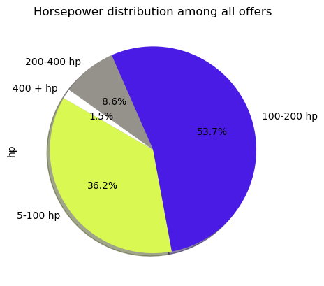
Horsepower
Horsepower
The lowest value of horsepower – 5 hp.
Microcar(Due, M.Go, M8), Renault Twizy, Ligier JS 50, Estrima Biro
Mercedes-benz G63 AMG has the highest 850 horsepower value
Almost 90 % of all offers have less than 200 horsepower

Slide 8
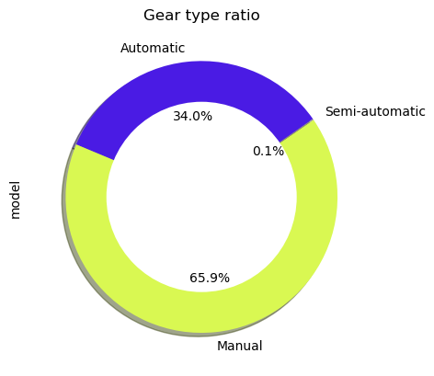
Transmission
Transmission
Most of the offers have Manual gear type – almost 30.500 cars
15.714 cars on Autoscaut24 have Automatic transmission
Only 56 offers have Semi-automatic gearbox

Slide 9
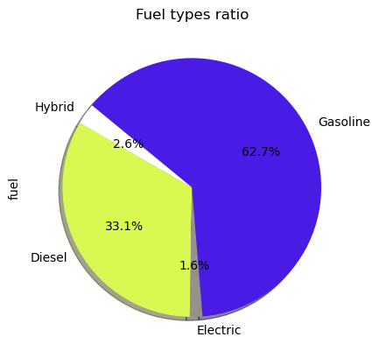
Fuel types
Fuel types
The most of cars – 28.869 use Gasoline fuel type
Diesel – 15.220, Hybrid – 1.203, Electric – 725 cars.
Gas vehicles are the least represented - 0.5% of the total number or 245 vehicles

Slide 10
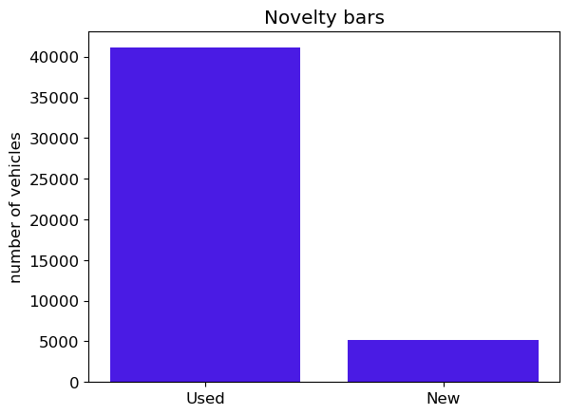
New or used?
New or used?
The dataset includes five different types of offers: pre-registered, used, demonstration, employee’s car, and new.
Most of the vehicles (41.116) represented on the website are used. 5.146 of the cars are new.

Slide 11
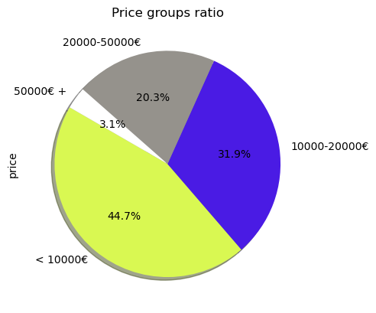
Price categories
Price categories
The most of cars – 20.664 are cheaper than 10.000€.
76.6%, or 35.434 offers, have price less than 20.000€, and 96.9% or 44805 are priced under 50.000€.
1.457 vehicles cost more than €50.000, with the most expensive costing 1.199.900€.
The cheapest car priced at 1.100€.

Slide 12
Price vs. Horsepower
Price vs. Horsepower
Price of the vehicle has strong positive correlation with horsepower
When the horsepower value of the car is higher than 400, the probability of huge price outliers increases.
Correlation between variables is stronger when HP value is lower than 450.

Slide 13
Fuel types by year
Fuel types by year
The number of electric and hybrid vehicles represented increases with the production year.
An anomaly was detected in the quantity of cars, produced in 2017: gasoline had the lowest value and diesel had its peak at the same time. The trend begins to reverse in 2018.
Gas cars by year have no pronounced trend. The chart is in flat.

Slide 14
Gear trends
Gear trends
In 2017 and later, the number of cars represented with automatic transmission has tend to increase, and in 2018, it surpassed the number of cars with manual transmission.
The quantity of vehicles with manual gear types tends to decrease with growing prices in each price group. The automatic car ratio tends to grow in each price group.

Slide 15
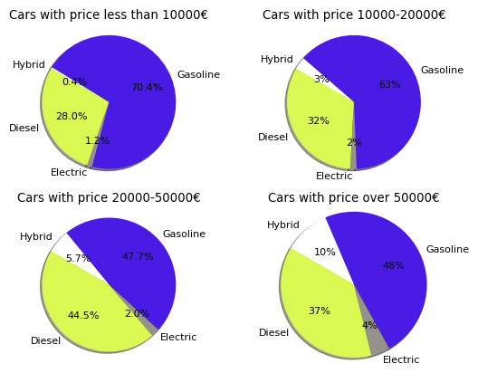
Fuel types in price
categories ratio
Fuel types in price
categories ratio
Gasoline cars are widely represented among cars with prices lower than €10.000. This ratio falls (7.4%) in the next group and falls below half in the next two groups.
Hybrid and electric vehicles' share of the total tends to grow with price in each price group.
The proportion of diesel vehicles increases with price in the first three groups while decreasing in the fourth.

Slide 16
Real price categories
by fuel types
Real price categories
by fuel types
The total quantity of gasoline, diesel, electric, and gas cars represented tends to decrease when prices increase.
The number of hybrid vehicles increases in the first three price categories while decreasing in the fourth.

Slide 17
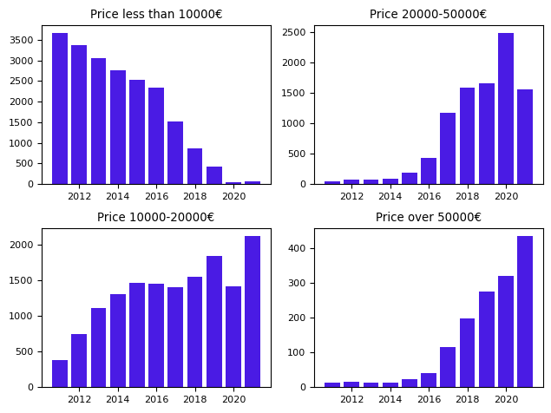
Price category trends
Price category trends
Cars with a price lower than 10.000€ tend to be less represented when production year increases
Vehicles with a price higher than 10.000€ tend to be more represented when production year increases

Slide 18










Top 10 popular brands
Top 10 popular brands
Brand | Average price, € | Cars represented | Average mileage
Volkswagen | 16060.09 | 6921.00 | 80881.04
Opel | 10428.03 | 4801.00 | 78416.94
Ford | 13793.37 | 4441.00 | 69201.89
Skoda | 13715.19 | 2877.00 | 70644.23
Renault | 11287.90 | 2828.00 | 57111.05
Audi | 30000.23 | 2681.00 | 76796.27
BMW | 23431.07 | 2400.00 | 97489.55
Mercedes-Benz | 28379.92 | 2347.00 | 96164.90
SEAT | 12847.43 | 1924.00 | 66158.88
Hyundai | 12852.69 | 1886.00 | 52792.60

Slide 19
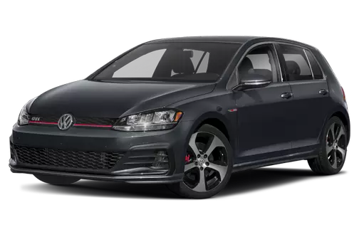
Top 10 popular models
Top 10 popular models
Brand | Model | Average price, € | Model represented | Average mileage
Volkswagen | Golf | 13540.55 | 1492.00 | 91738.14
Opel | Corsa | 8959.63 | 1491.00 | 55012.01
Ford | Fiesta | 9864.22 | 1289.00 | 52437.59
Opel | Astra | 9574.46 | 1191.00 | 101118.97
Ford | Focus | 12428.89 | 985.00 | 83752.35
Volkswagen | up! | 7622.25 | 945.00 | 55040.93
Skoda | Fabia | 10170.06 | 917.00 | 55746.15
Volkswagen | Polo | 10053.58 | 893.00 | 68183.68
smart | forTwo | 7878.90 | 725.00 | 55304.53
Fiat | 500 | 11022.25 | 666.00 | 25588.98

Slide 20
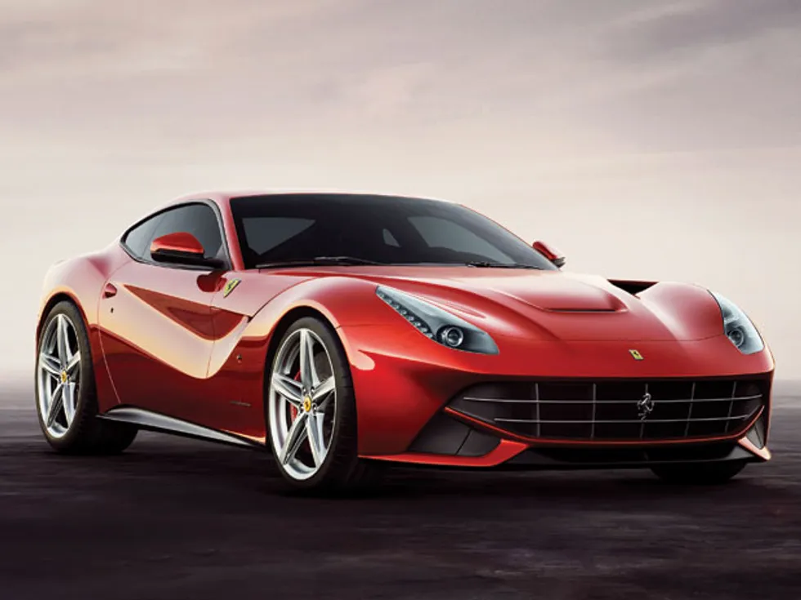
Top 10 expensive cars
Top 10 expensive cars
Brand | Model | Price, € | Horsepower | Mileage
Ferrari | F12 | 1199900 | 775.00 | 431
Mercedes-Benz | S 650 | 717078 | 630.00 | 90
Maybach | Pullman | 717078 | 630.00 | 90
Maybach | Pullman | 499800 | 530.00 | 3400
Mercedes-Benz | SLS | 465000 | 591.00 | 350
Lamborghini | Aventador | 449900 | 770.00 | 3600
Ferrari | 812 | 439900 | 799.00 | 6500
Lamborghini | Aventador | 439900 | 770.00 | 14090
Lamborghini | Aventador | 399999 | 700.00 | 1200
Porsche | 991 | 399911 | 700.00 | 4624

Slide 21
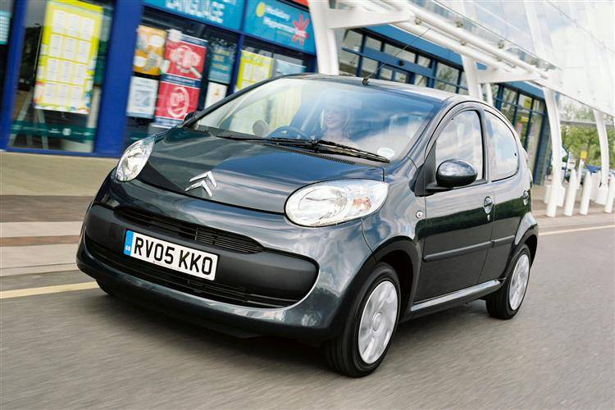
Top 10 cheapest cars
Top 10 cheapest cars
Brand | Model | Price,€ | HP | Average mileage
Citroen | C1 | 1100 | 68.00 | 204000
Lada | Priora | 1190 | 98.00 | 100611
Toyota | Aygo | 1250 | 68.00 | 153000
Peugeot | 206 | 1299 | 68.00 | 222000
Opel | Corsa | 1300 | 69.00 | 133000
Volkswagen | Touran | 1396 | 140.00 | 233567
Brilliance | BS4 | 1500 | 101.00 | 100524
SEAT | Ibiza | 1500 | 69.00 | 170000
smart | forTwo | 1500 | 54.00 | 140000
Fiat | Panda | 1500 | 69.00 | 157000

Slide 22
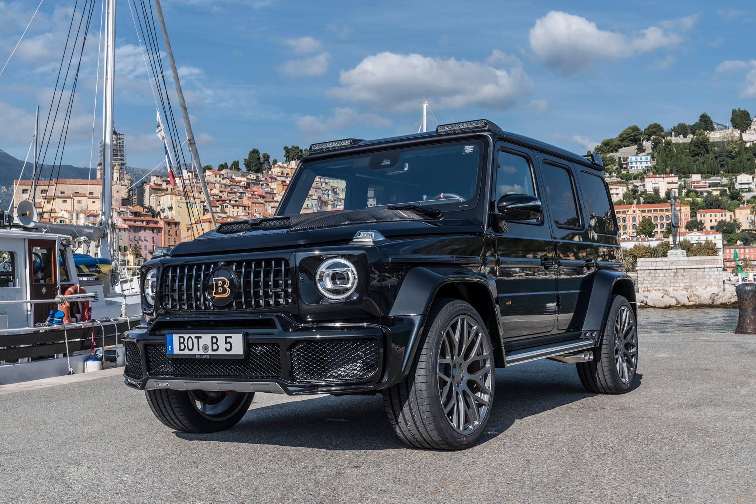
Top 10 powerful
Top 10 powerful
Brand | Model | Price | Horsepower | Mileage
Mercedes-Benz | G 63 AMG | 216619 | 850.00 | 9234
Audi | R8 | 295000 | 799.00 | 11000
Ferrari | 812 | 439900 | 799.00 | 6500
Ferrari | F12 | 1199900 | 775.00 | 431
Tesla | Model S | 54450 | 772.00 | 71099
Tesla | Model X | 99999 | 772.00 | 63205
Ford | Mustang | 121000 | 771.00 | 50
Lamborghini | Aventador | 439900 | 770.00 | 14090
Lamborghini | Aventador | 449900 | 770.00 | 3600
Corvette | Z06 | 148600 | 767.00 | 9790

Slide 23
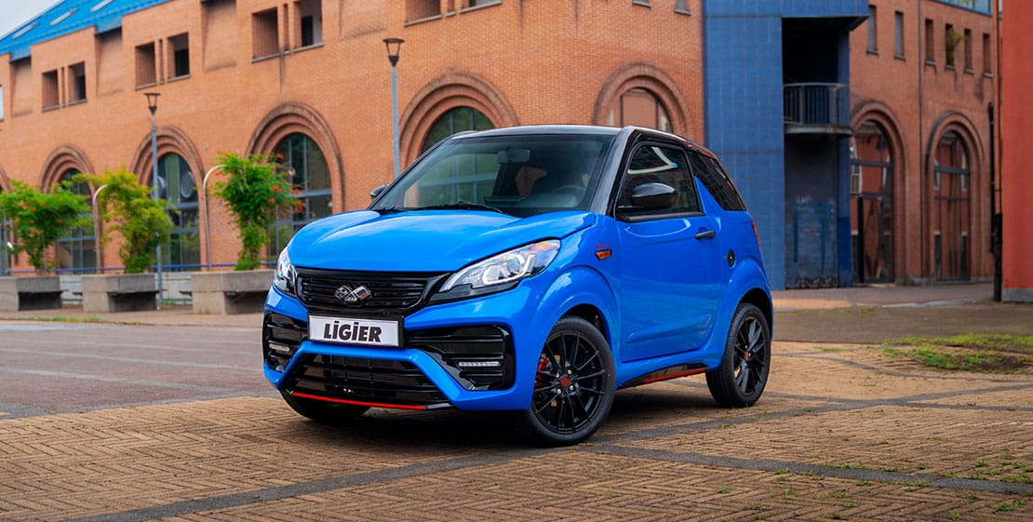
Top 10 least horsepower
Top 10 least horsepower
Brand | Model | AVG Price | HP
Ligier | JS 50 | 9570.00 | 5.00
Estrima | Birò | 13090.00 | 5.00
Microcar | M.Go | 8262.86 | 5.86
Microcar | M8 | 6149.50 | 6.00
Aixam | City | 12935.00 | 6.50
Microcar | Due | 6745.00 | 7.50
Piaggio | Ape | 7849.75 | 10.25
Renault | Twizy | 5413.43 | 10.74
Tazzari | EV Zero Classic | 6500.00 | 20.00
Zhidou | D2S | 12500.00 | 24.00

Slide 24
Conclusion
Conclusion
In this project, an analysis of data on German cars from the Autoscaut24 website was carried out.
Relationships, interesting trends between variables were identified.
An anomaly was discovered in 2017. Gasoline cars are the least represented in this year's production, while diesel cars are the most widely represented. Also this year and after, there is a downward trend in the number of cars with a manual transmission and an increase in the number of automatic ones.
The analysis was done using Python in Jupiter notebooks. See my GitHub portfolio
github.com/paulo81818

Slide 25
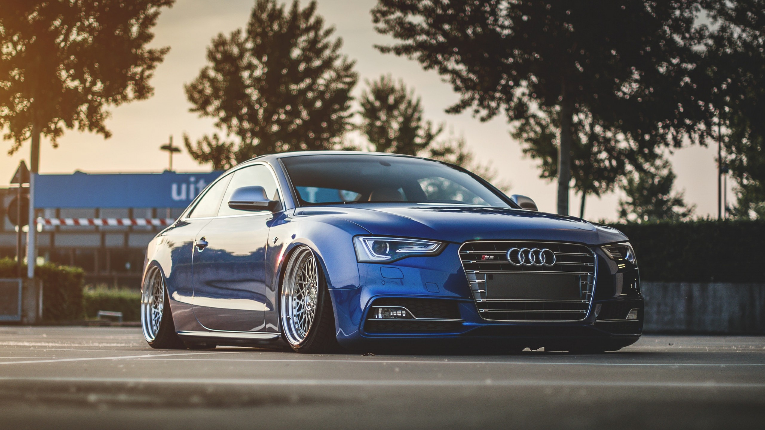
Thank You for attention!

